Slide 1
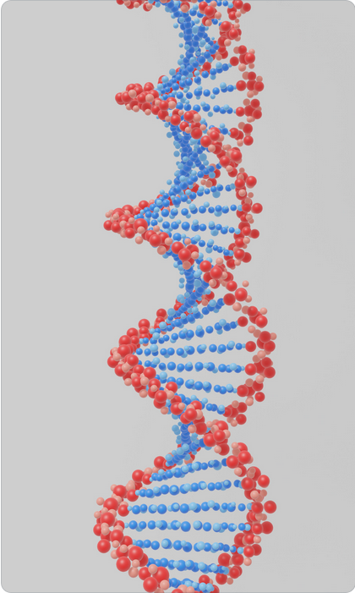
ISAB AWARD for research results
presented at the ISAB meeting held on October 6, 2022 at the Institute of Biophysics,
Czech Academy of Sciences
RNDr. Miroslav Krepl, Ph.D.
prof. Mary Anne O'Connell, Ph.D.
On behalf of ISAB members

